Slide 1
COMM 1011-
Fundamentals of Communication
Chapter 1
University of Colorado Denver

Slide 2
What is human communication?
A transactional process through which people generate meaning through the exchange of verbal and nonverbal messages in specific contexts, influenced by individual and societal forces and embedded in culture.

Slide 3
Seven components of communication
Message creation
Meaning creation
Setting
Participants
Channels
Noise
Feedback

Slide 4
1) Message creation
* Encoding
* Decoding
* Symbolic nature of communication which is arbitrary
2) Meaning creation
Content meaning
  Denotative meaning
  Connotative meaning

Slide 5
Setting – physical context
Participants – relational context
Channels
Noise – external & internal
Feedback – interplay

Slide 6
Models of communication
Linear model
Synergistic model/transactional model (greater than sum)
  Dynamic
  Simultaneous
  Interpretive
  Contextual

Slide 7
Communication Influences
Communication is influenced by individual forces
  Field of experience, but individualism is constrained
Communication is influenced by societal forces
  Political/social discourse
Communication is influenced by culture
  Expectations, values, norms
Communication is influenced by context
  Physical context

Slide 8
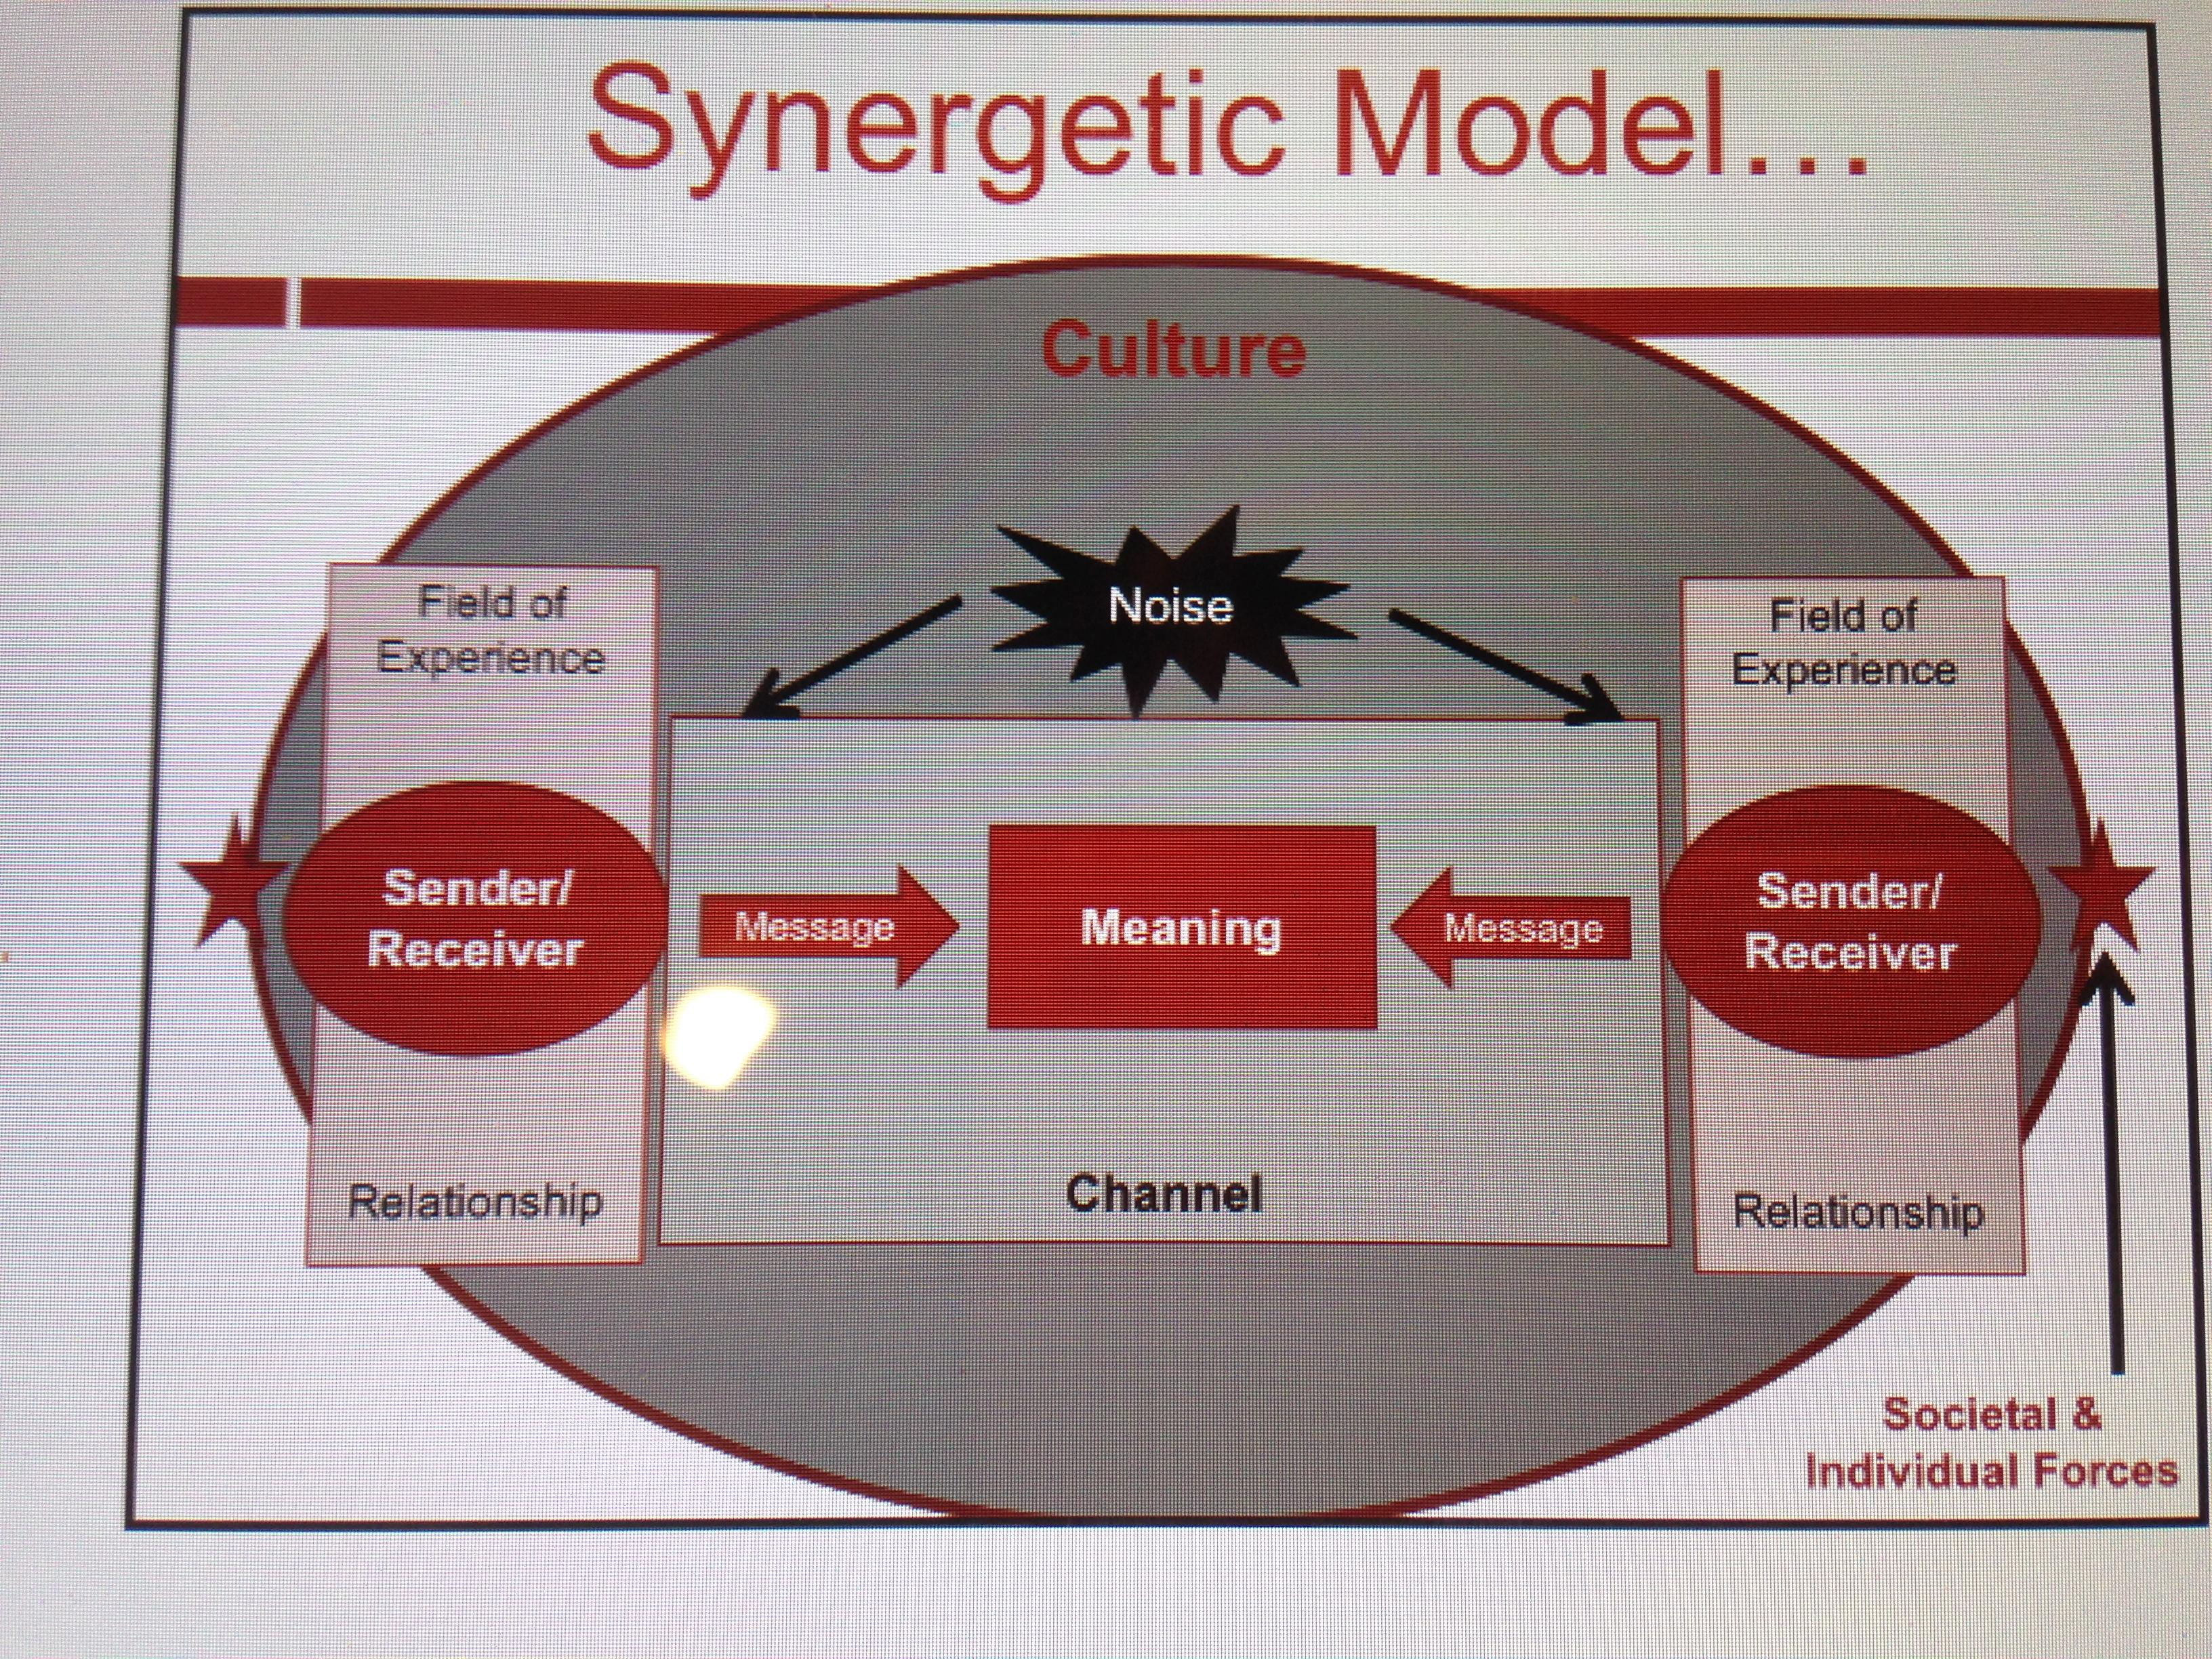

Slide 9
Communication Ethics
Ethics: Standards of what is right and wrong, good and bad, moral and immoral
Communication ethics: Standards of right and wrong that one applies to messages that are sent and received
  Truthfulness
  Sharing or withholding information (privacy vs. secrecy in disclosure)
  Benefit and harm of a message
  Absolutism vs. relativism
  Intent vs. impact
Not binding—flexible across range and context

Slide 10
Putting it all together
Communicating with competence
  Appropriateness
  Effectiveness

